Slide 1
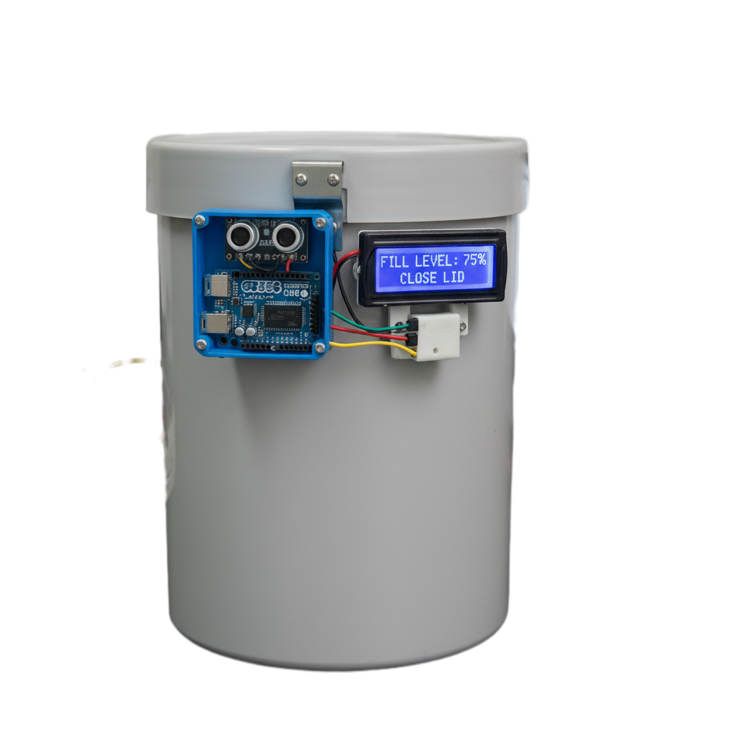
SMART DUSTBIN
.

Slide 2
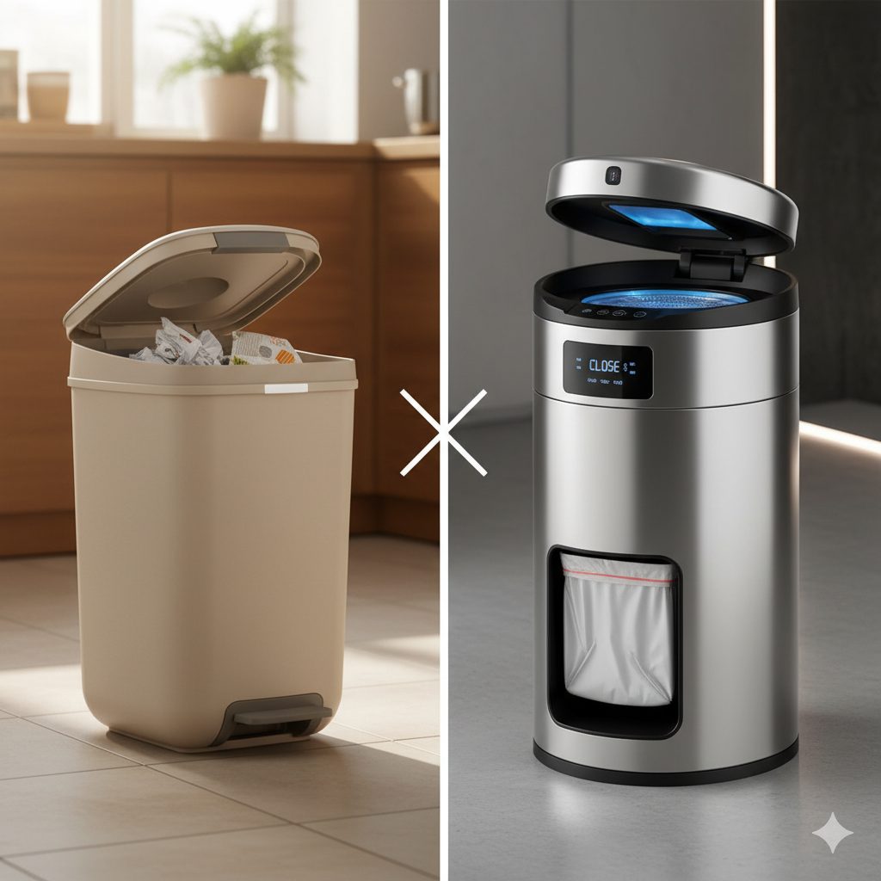
Introduction
Waste management is a major problem.
Traditional dustbins require manual touch, which is unhygienic.
Smart dustbins use sensors and automation to open the lid automatically when someone approaches.
The smart dustbin helps in maintaining cleanliness and promoting hygiene.

Slide 3
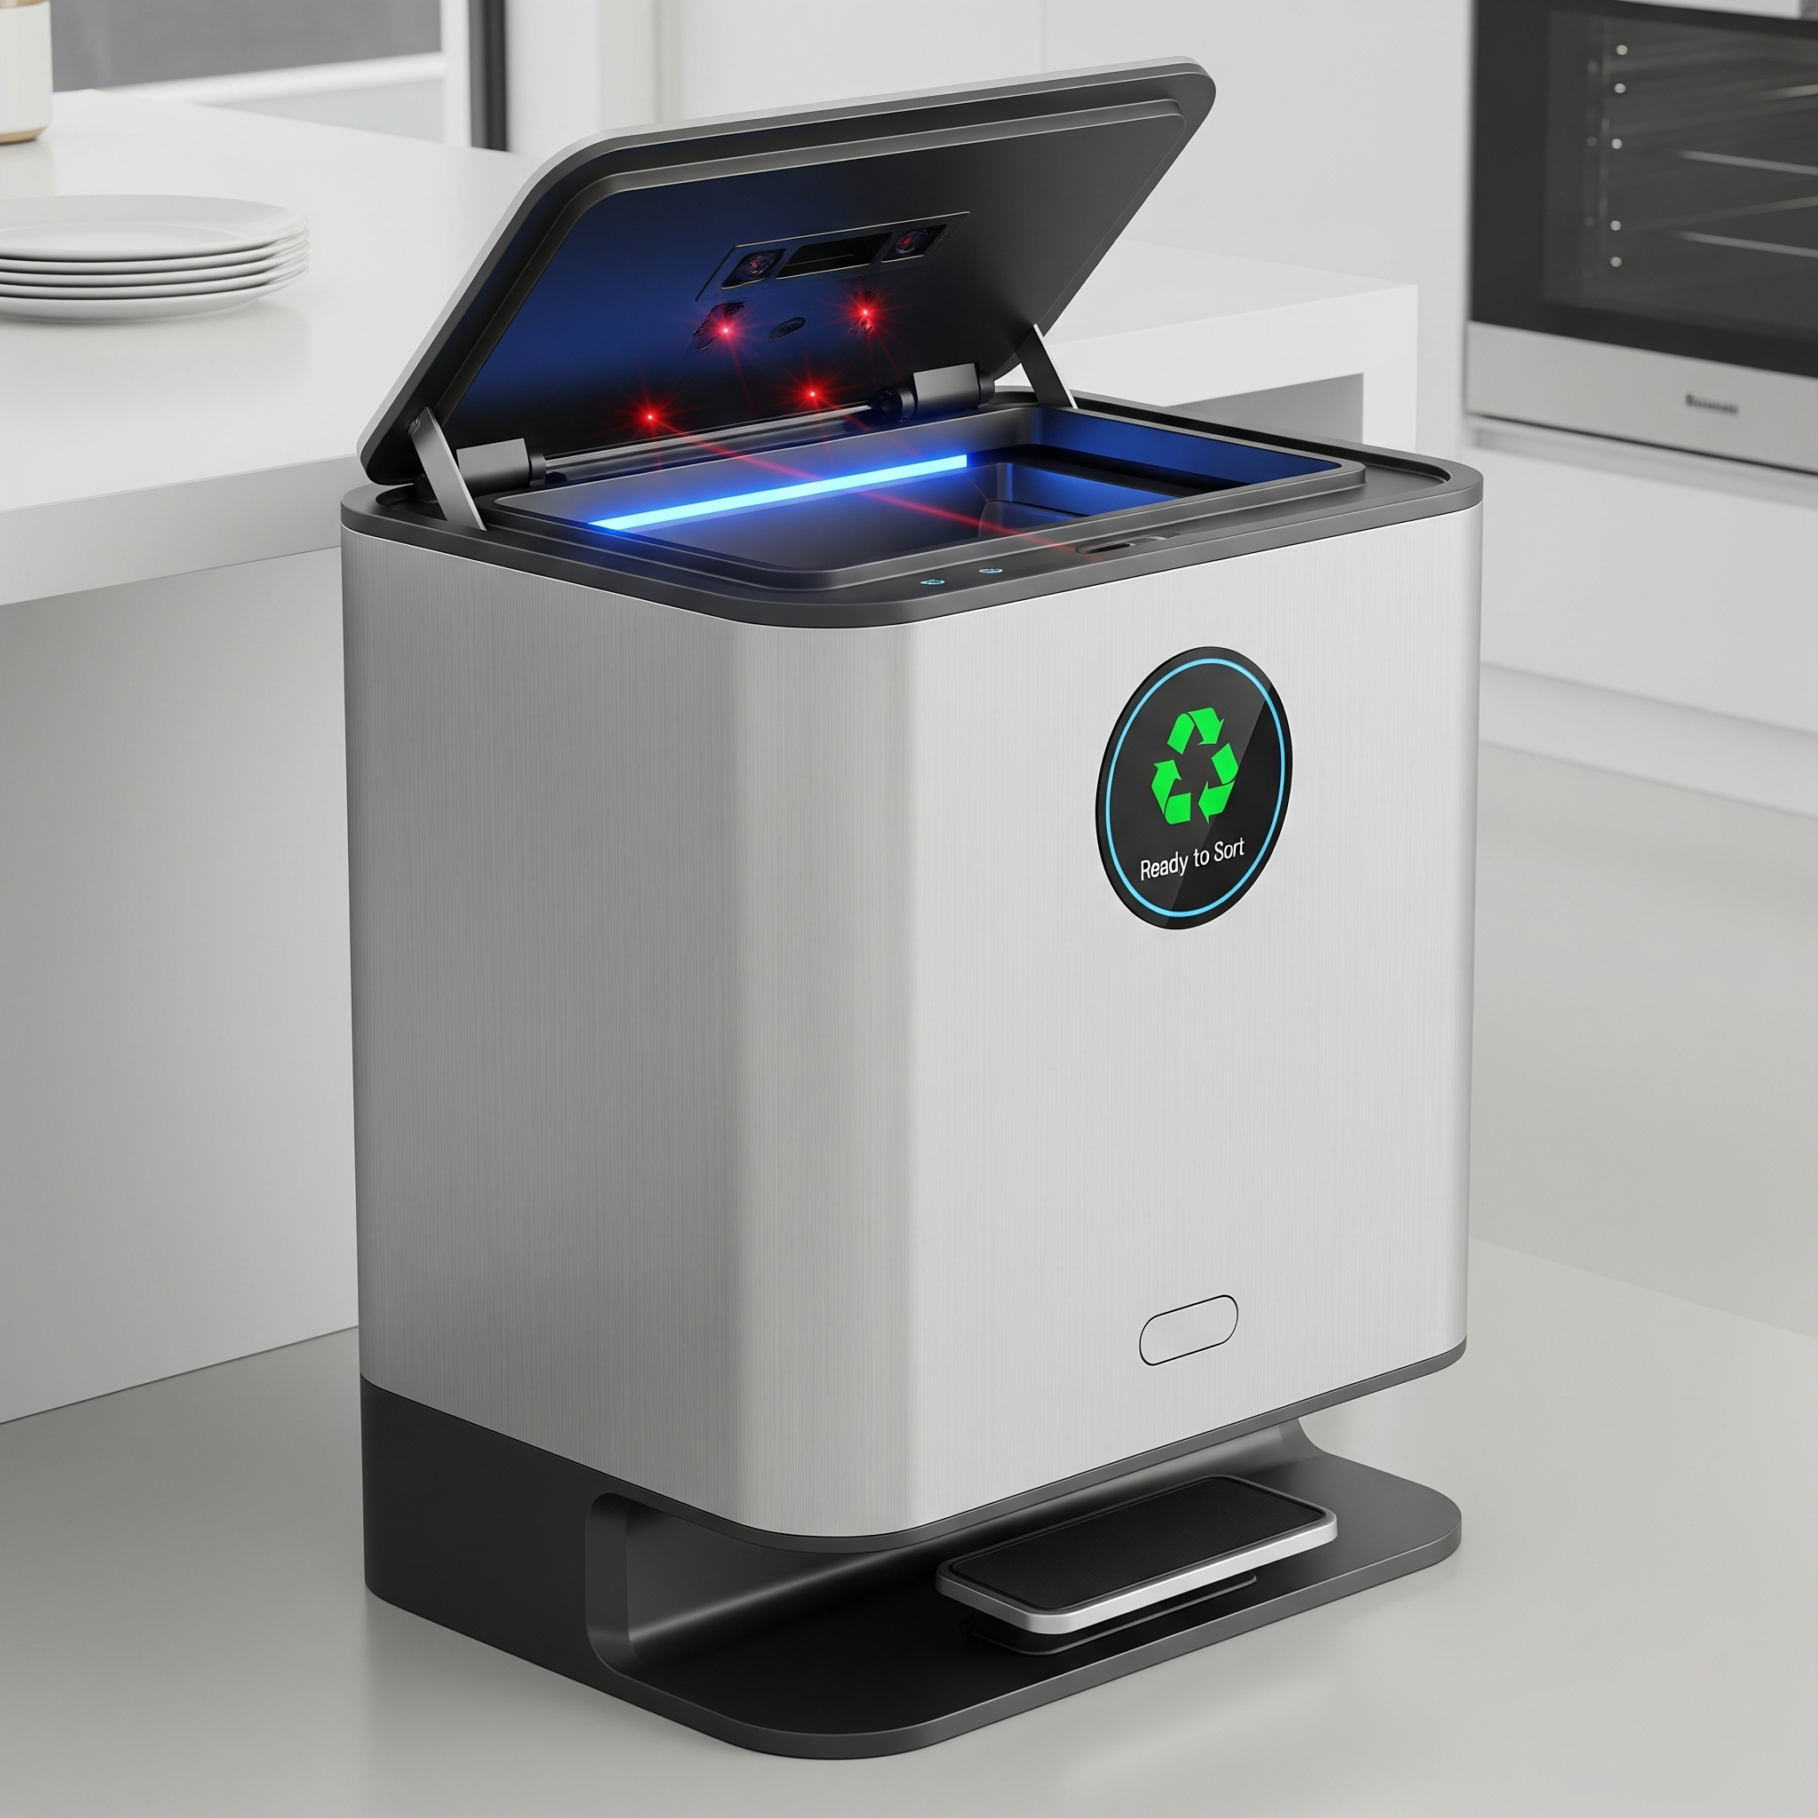
Project Objectives
Design an automatic dustbin using sensors and a microcontroller.
Implement automatic lid opening when someone approaches.
Obtain information about the garbage fill level.

Slide 4
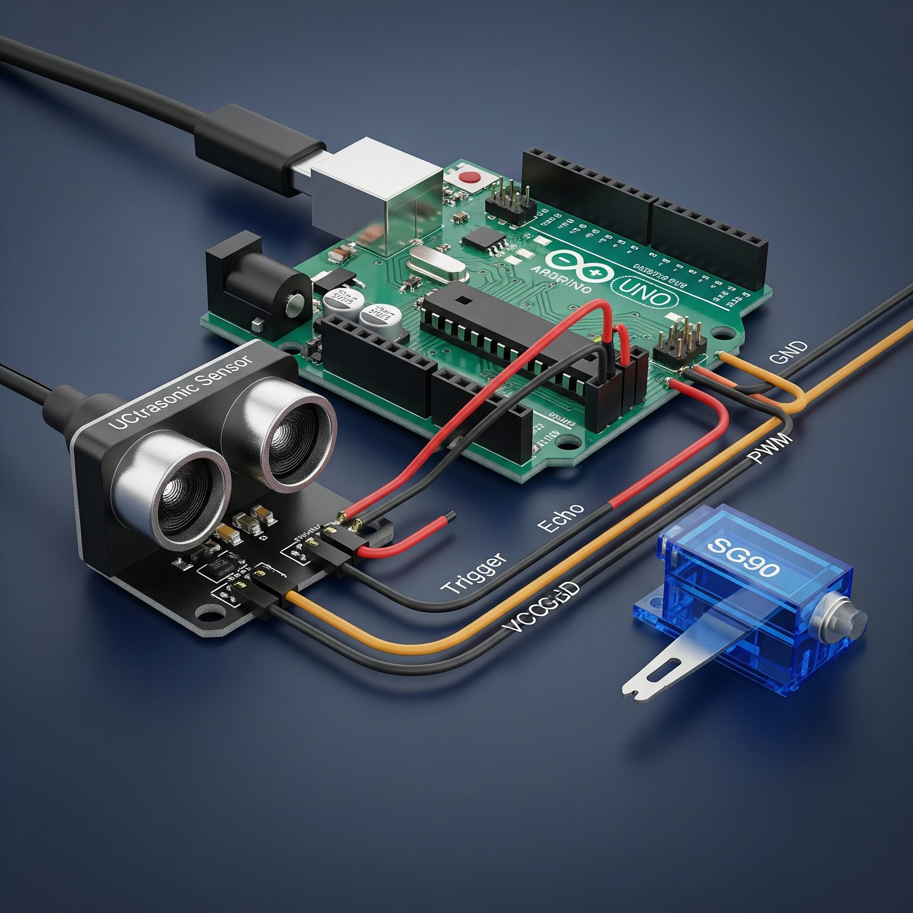
Project Components Overview
The system requires an Arduino Uno microcontroller
Use ultrasonic sensor for distance measurement
A servo motor controls the automated lid opening
Power the entire system using a battery source

Slide 5
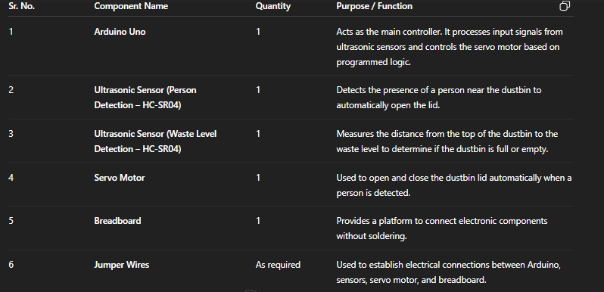
Components and purpose
.

Slide 6
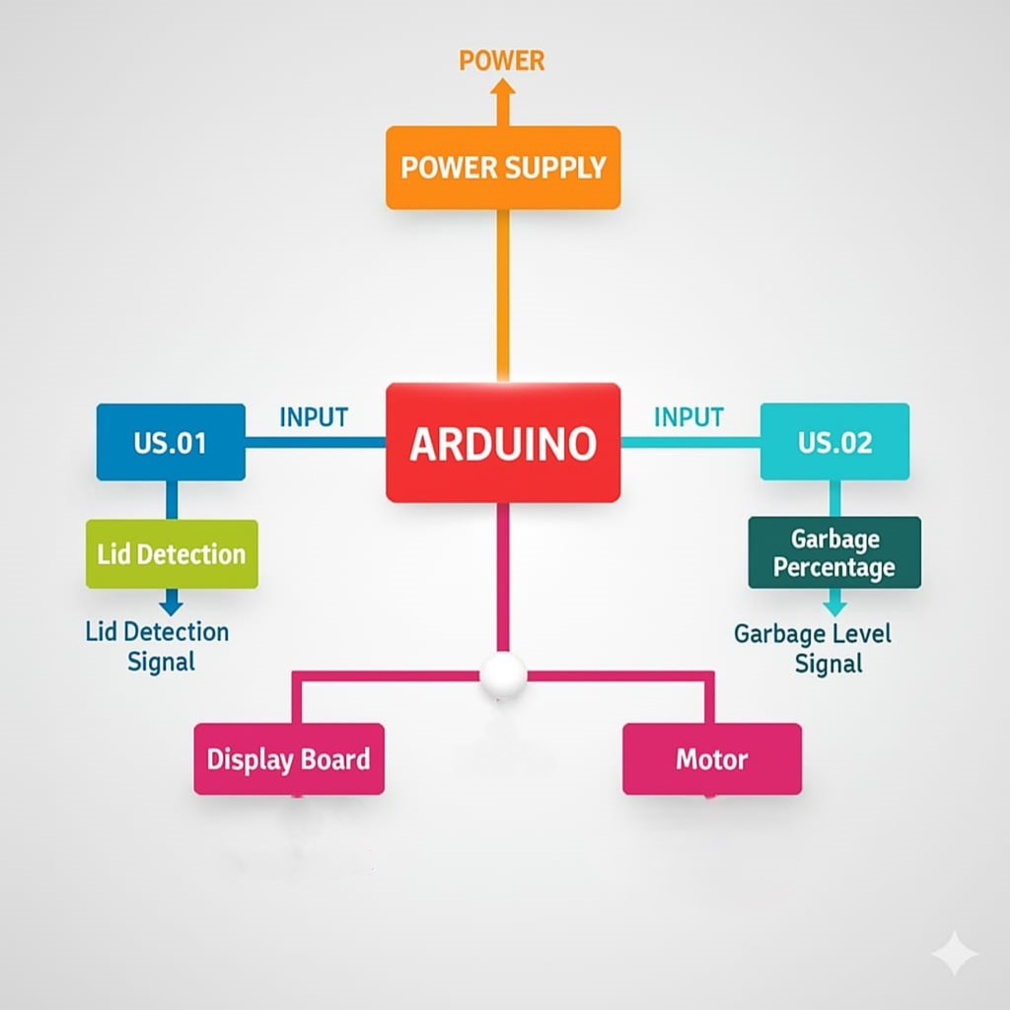
BLOCK DIAGRAM
.

Slide 7
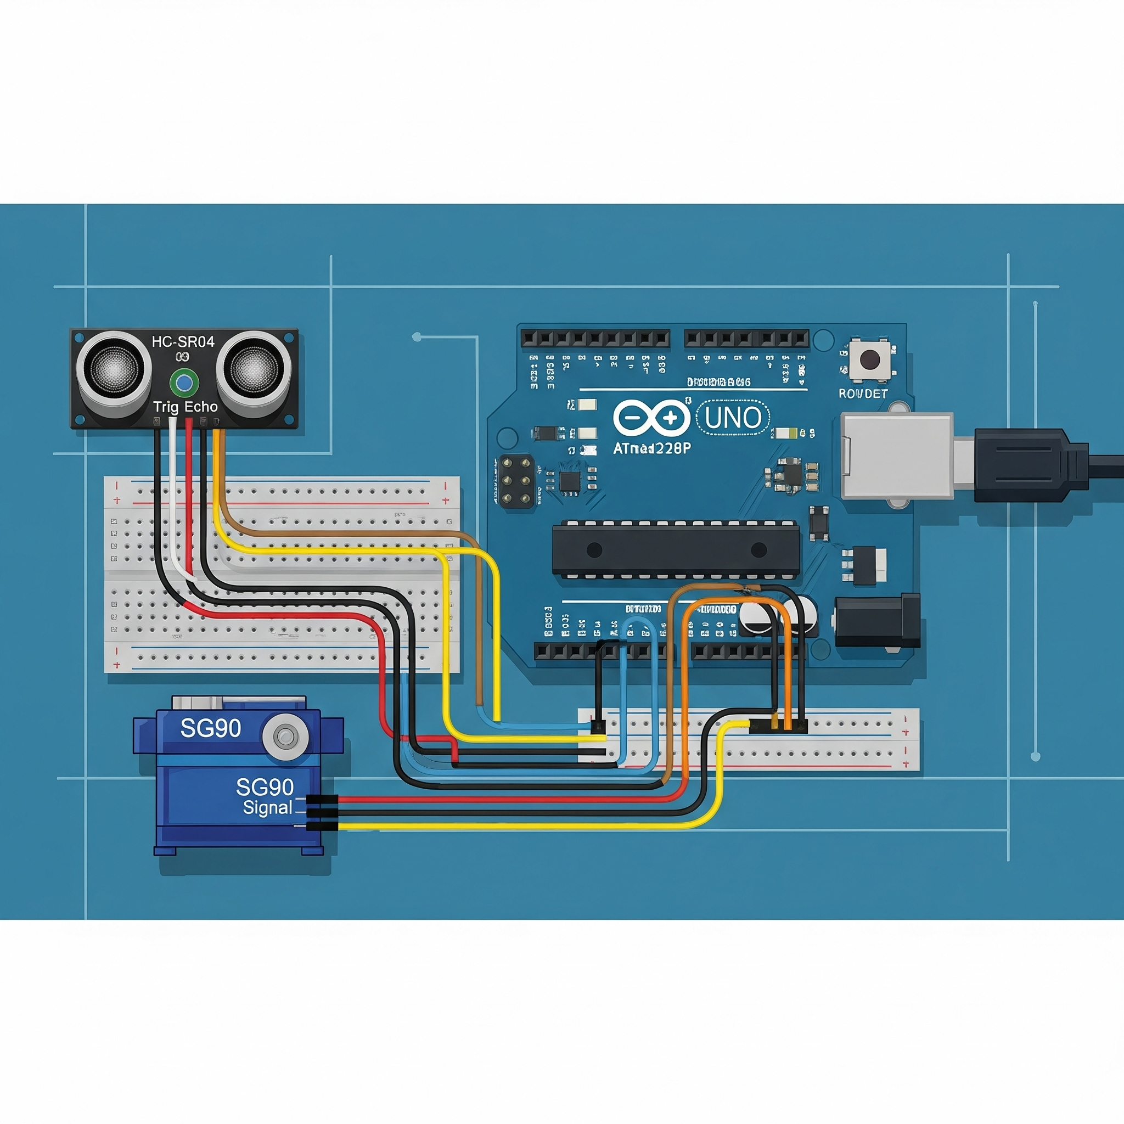
WORKING
PRINCIPLE
Arduino continuously pings the HC-SRO4 (a ultrasonic sensor) which sends a small ultrasonic pulse.
Ultrasonic sensor measures distance to detect presence
HC-SRO 4 measure time untill echo (pulse) returns, Arduino converts that to distance.
Servo motor handles the automatic opening of the lid

Slide 8
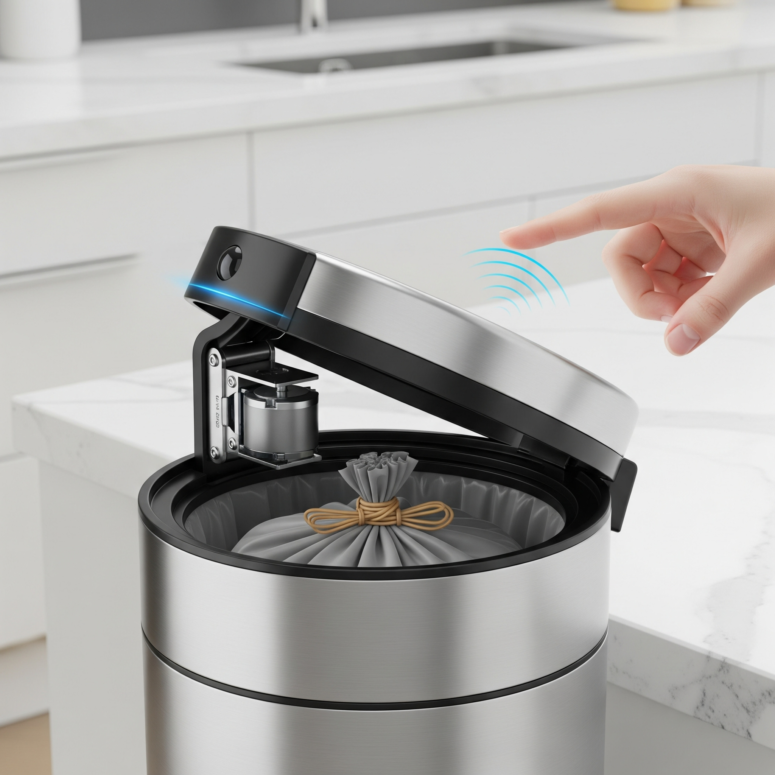
SMART DUSTBIN WORKFLOW
1 Arduino continuously pings the HC-SRO4 (a ultrasonic sensor) which sends a small ultrasonic pulse.
2. HC-SRO 4 measure time until echo (pulse) returns, Arduino converts that to distance.
3. If the measured distance is smaller than fixed distance and the lid is closed, Arduino drives servo to open at certain angle.
4. Arduino starts a timer or after short wait Arduino drivers servo back to close the lid.
5. The ultrasonic sensor inside the dustbin gives continuous information of how much dustbin is filled
6. This process get repeat.
.

Slide 9
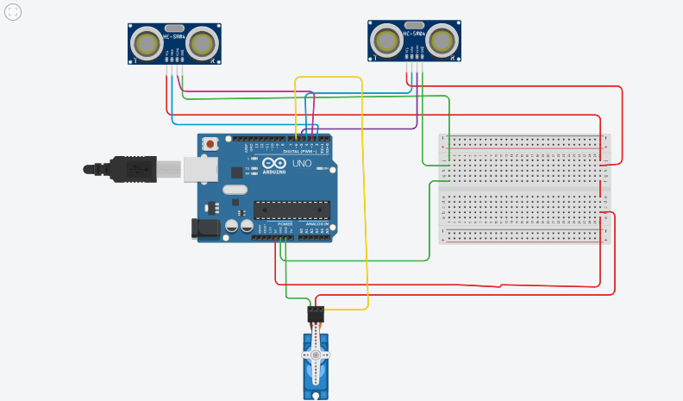
CIRCUIT DIAGRAM
.

Slide 10
CODE

Slide 11
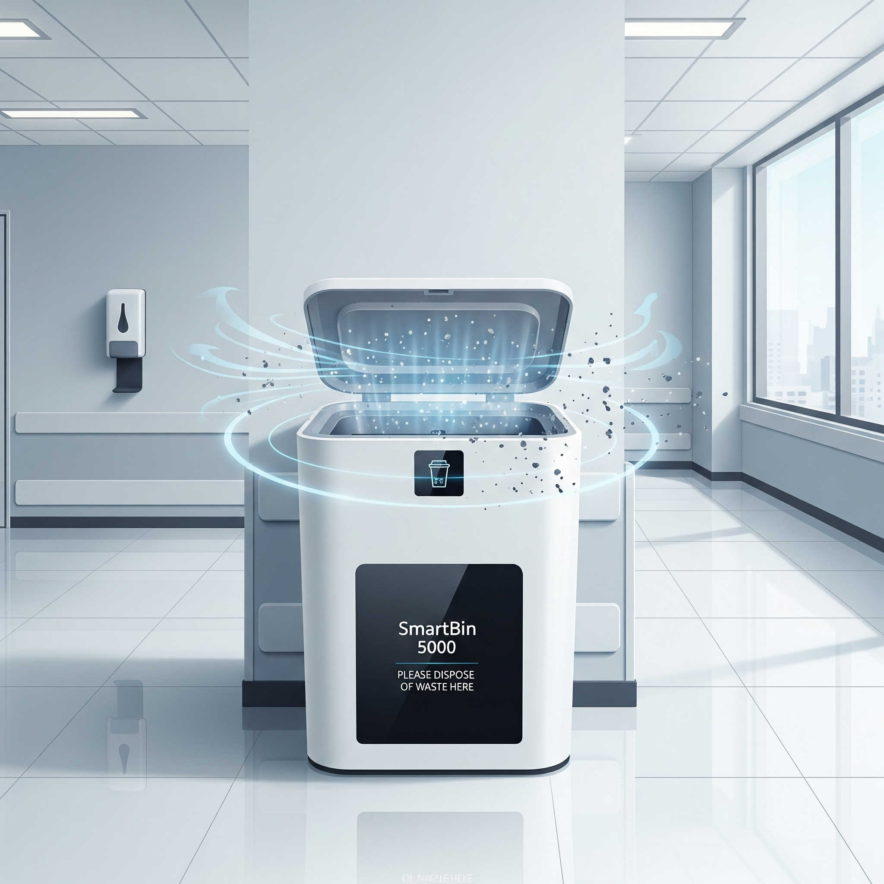
Project Applications
IHomes and offices
Parks and malls
Hospitals and schools
Smarts cities (IoT Integration)

Slide 12
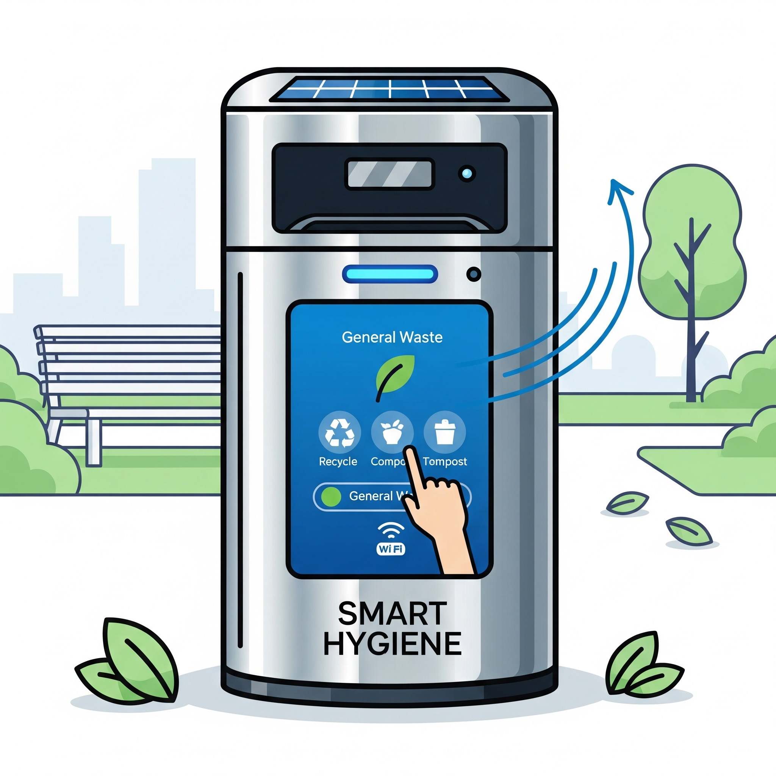
Smart Dustbin Advantages
Improves sanitation and promotes better public hygiene
Reduces the need for manual and direct lid contact
Provides real-time data about the garbage fill level
Offers a more efficient and cleaner waste disposal process

Slide 13
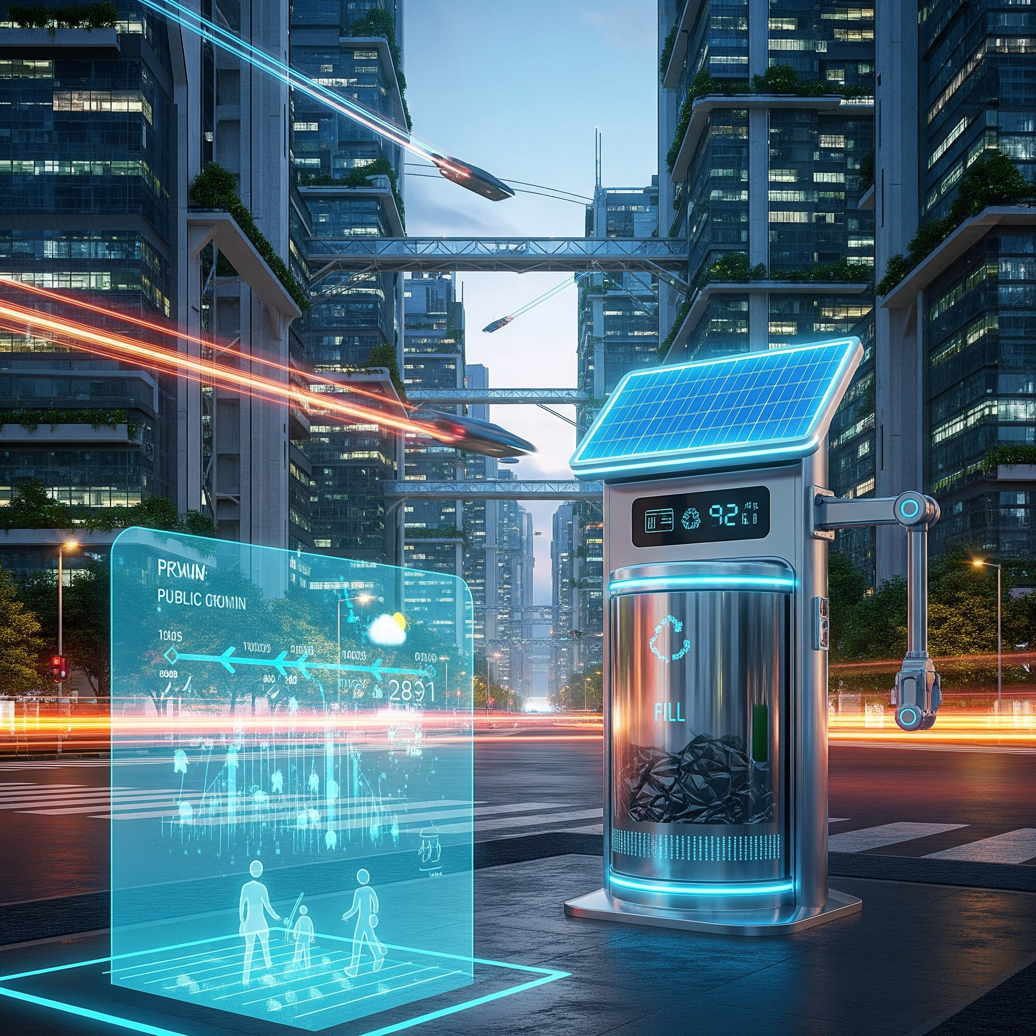
Future Scope of Smart Dustbin
Smart dustbin which can dump
Waste by its own.
Utilizing machine learning for waste segregation and analysis
Adding solar panels for a fully self-sustained power source
Developing mobile app notifications for fill levels and maintenance

Slide 14
Thank you!
ANY QUESTIONS?

